Slide 1
TOPOLOGICAL SORT
DONE BY
D.STELLA
A.SHEREEN FATHIMA
ALGORITHM ANALYSIS LAB(CSB3105)
B.S.ABDUR RAHMAN UNIVERSITY

Slide 2
Overview
Preface
Problem Statement
What is Topological Sorting
Visual Representation
The problem to be solved
The algorithm behind it
Algorithm Analysis
Result
To be discussed in the presentation

Slide 3

PREFACE
Problem
Description
Student
Activities
Topological
sort
Algorithm of
topology
sorting
Complexity
Of an algorithm

Slide 4
PROBLEM STATEMENT
Students have various activities to be done everyday.
Such activities range from studying to eating to napping and so on.
The major problem; How can all these activities be achieved, along with time management and also organization and optimization of the activities.

Slide 5
WHICH IDEAL ALGORITHM IS USED TO SORT THE STUDENT ACTIVITIES?

Slide 6
Topological Sort
A topological sort or topological ordering of a directed graph is a linear ordering of its vertices such that for every directed edge uv from vertex u to vertex v, u comes before v in the ordering.
Define

Slide 7
Topological sorting algorithm
Done in a way that for every edge ab from vertex a to b, the vertex a comes before the vertex b in the topological ordering.
In other words, the topological sorting of a Directed Acyclic Graph is linear ordering of all of its vertices.
Technically

Slide 8
ALGORITHM FOR TOPOLOGICAL SORT
Compute the indegrees of all vertices
Find a vertex U with indegree 0 and print it (store it in the ordering)If there is no such vertex then there is a cycle and the vertices cannot be ordered. Stop.
Remove U and all its edges (U,V) from the graph.
Update the indegrees of the remaining vertices.
Repeat steps 2 through 4 while there are vertices to be processed

Slide 9
Representation
1
2
3
4
5
Consider this
6
7

Slide 10
Indegrees
0: 1, 2
1: 5
2: 3, 6, 7
3: 4
1
2
3
4
5
Select 1
6
7
1

Slide 11
Indegrees
0: 1, 2
1: 5
2: 3, 6, 7
3: 4
1
2
3
4
5
Select 1, 2
6
7
1 | 2

Slide 12
Indegrees
0: 1, 2
1: 5
2: 3, 6, 7
3: 4
1
2
3
4
5
Select 1, 2, 5
6
7
1 | 2 | 5

Slide 13
Indegrees
0: 1, 2
1: 5
2: 3, 6, 7
3: 4
1
2
3
4
5
Select 1, 2, 5, 4
6
7
1 | 2 | 5 | 4

Slide 14
Indegrees
0: 1, 2
1: 5
2: 3, 6, 7
3: 4
1
2
3
4
5
Select 1, 2, 5, 4, 3
6
7
1 | 2 | 5 | 4 | 3

Slide 15
Indegrees
0: 1, 2
1: 5
2: 3, 6, 7
3: 4
1
2
3
4
5
Select 1, 2, 5, 4, 3, 6
6
7
1 | 2 | 5 | 4 | 3 | 6

Slide 16
Indegrees
0: 1, 2
1: 5
2: 3, 6, 7
3: 4
1
2
3
4
5
Select 1, 2, 5, 4, 3, 6, 7
6
7
1 | 2 | 5 | 4 | 3 | 6 | 7

Slide 17
Topologically sorted
1
2
3
4
5
6
7
1 | 2 | 5 | 4 | 3 | 6 | 7

Slide 18
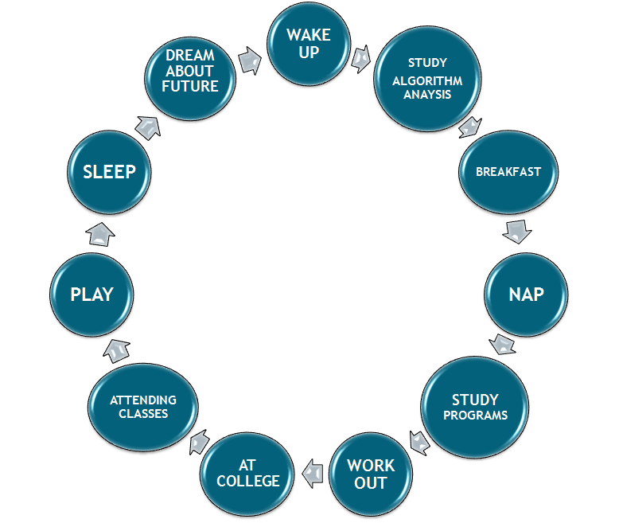
Student Activity Optimization
These are the list of activities performed by the student.
They need to be ordered to enhance time management of the student and increase the optimization of the activities done.
Hence, this problem is named as “Student Activity Organization”

Slide 19
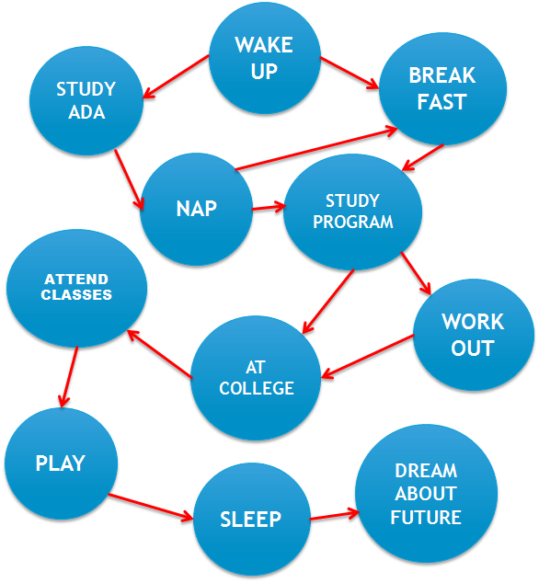
The activities are drawn into nodes and the entire activity chart is made into a Graph

Slide 20
ALGORITHM FOR TOPOLOGICAL SORT
Compute the indegrees of all activity vertices
Find an activity vertex x with indegree 0 and print it (store it in the queue).
If there is no such vertex then there is a cycle and the vertices cannot be ordered. Stop.
Remove x and all its edges (U,V) from the graph.
Update the indegrees of the remaining activity vertices.
Repeat steps 2 through 4 while there are activity vertices to be processed.

Slide 21
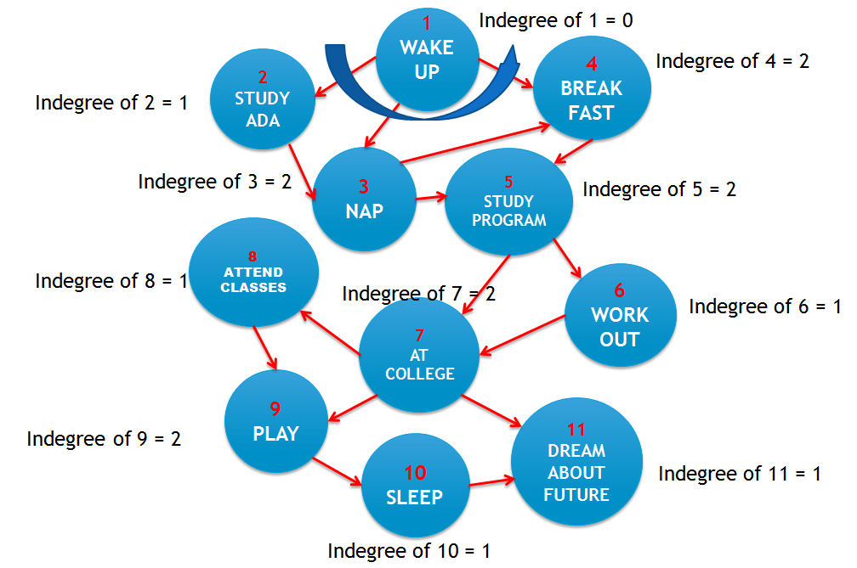

Slide 22
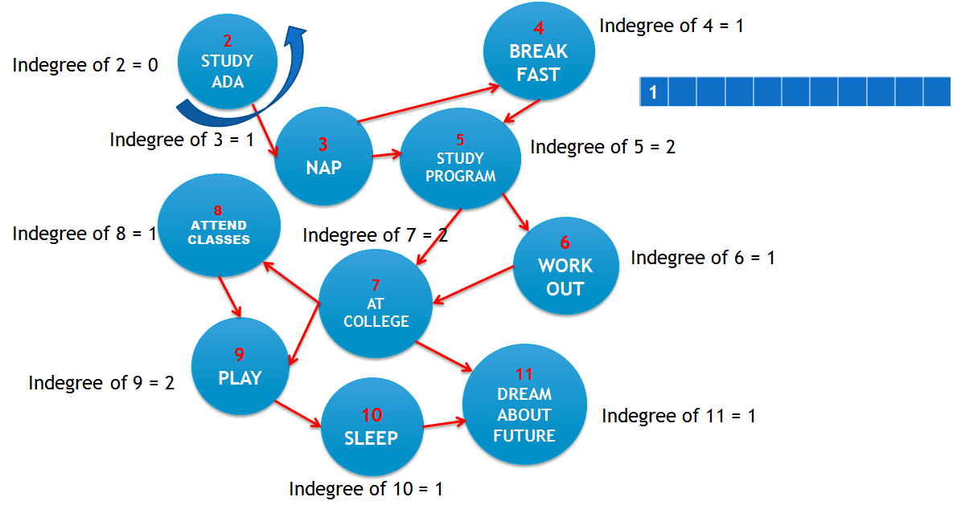
QUEUE

Slide 23
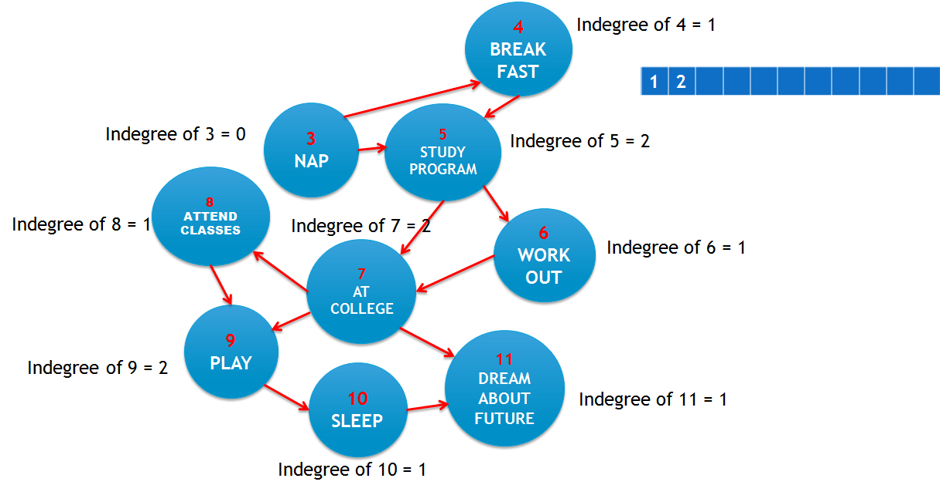
QUEUE
2

Slide 24
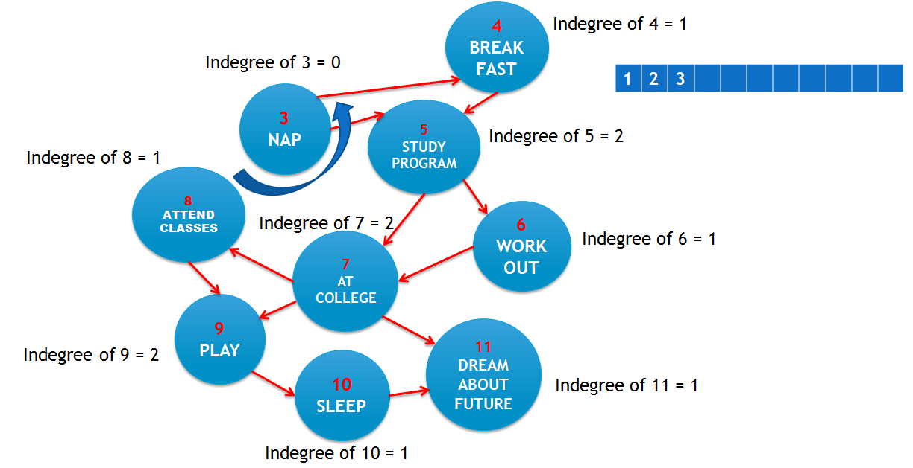
QUEUE

Slide 25
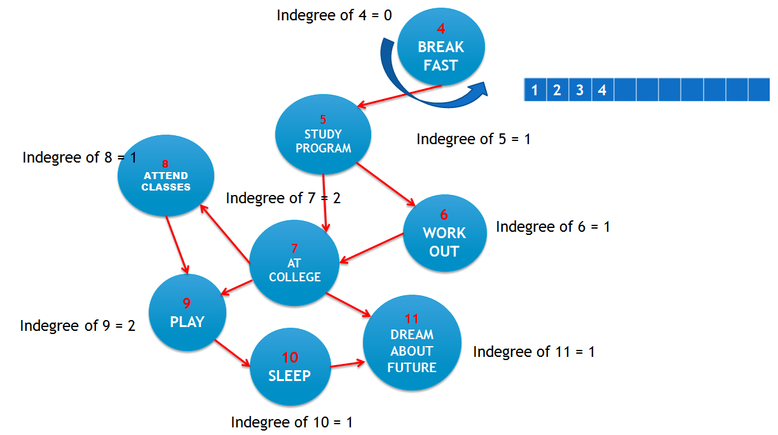
QUEUE

Slide 26
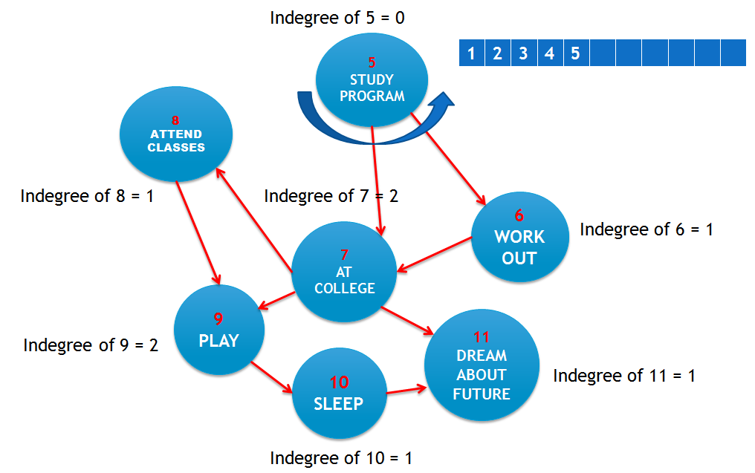
QUEUE

Slide 27
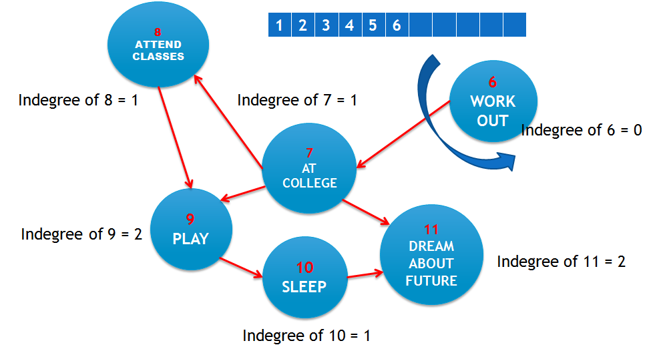
QUEUE
QUEUE

Slide 28
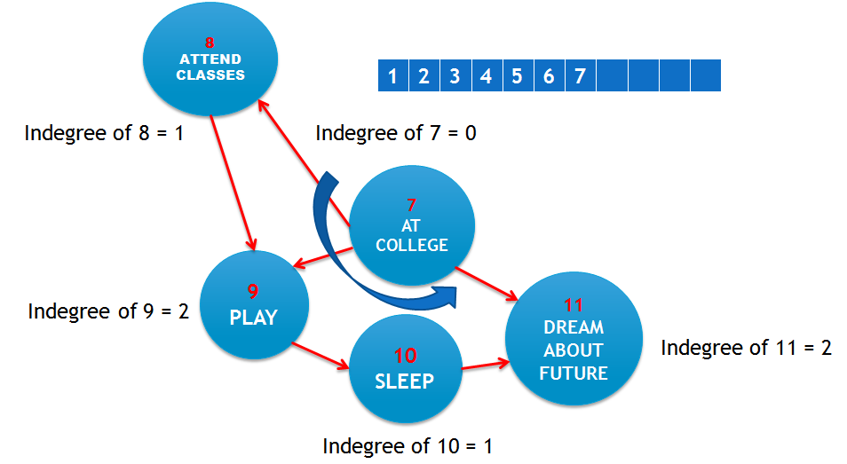
QUEUE

Slide 29
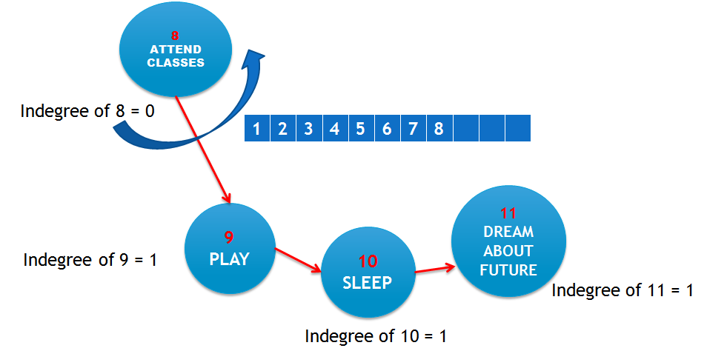
QUEUE

Slide 30
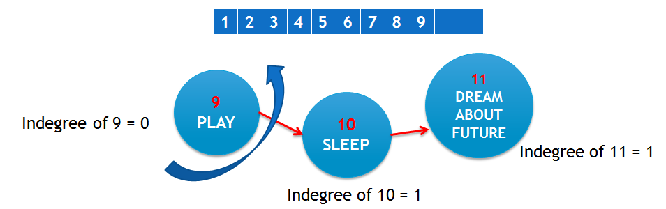
QUEUE

Slide 31
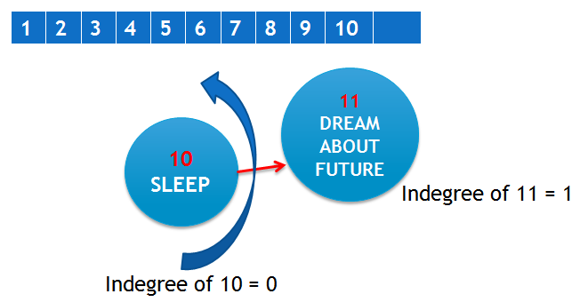
QUEUE

Slide 32
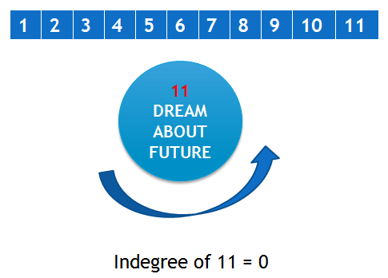
QUEUE

Slide 33
Optimized Student Activities
Wake up
Study ADA
Nap
Breakfast
Study Program
6. Workout
7. At College
8. Attend class
9. Play
10. Sleep
11. Dream
1 | 2 | 3 | 4 | 5 | 6 | 7 | 8 | 9 | 10 | 11

Slide 34

TOPOLOGICAL SORT
ALGORITHM ANALYSIS

Slide 35
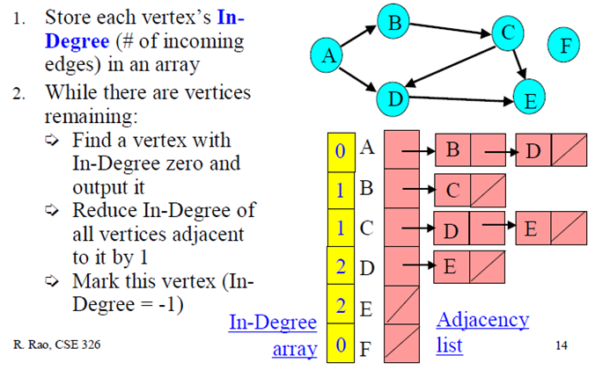
Store each vertex’s In-degree
in an array.
2.While there are vertices remaining:
Find a vertex with In-degree zero and output it
Reduce In-degree of all vertices
adjacent to it by 1
3.This algorithm running time will be a quardratic time.

Slide 36
COMPLEXITY OF AN ALGORITHM
For input graph G = (V,E), Run Time = ?
Break down into total time required to:
§ Initialize In-Degree array: O(|E|)
§ Find vertex with in-degree 0:|V| vertices, each takes O(|V|) to search In-Degree array.
§ Reduce In-Degree of all vertices adjacent to a vertex: O(|E|)
§ Output and mark vertex:O(|V|)
§ Total time = O(|V|²)
§ Total time= O(|V|² + |E|) Quadratic time!

Slide 37
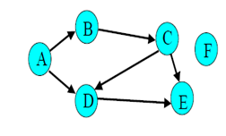
Topological sort (using array along with queue)
1.Store each vertex’s In-Degree in an array
2. Initialize queue with all “in-degree=0” vertices
3. While there are vertices remaining in the
queue:
(a) Dequeue and output a vertex
(b) Reduce In-Degree of all vertices adjacent to it by 1
(c) Enqueue any of these vertices whose In-Degree
became zero
4. If all vertices are output then success,
otherwise there is a cycle.

Slide 38
Complexity of an algorithm Initialize In-Degree array: O(|V| + |E|) Initialize Queue with In-Degree 0 vertices: O(|V|) Dequeue and output vertex: › |V| vertices, each takes only O(1) to dequeue and output: O(|V|) Reduce In-Degree of all vertices adjacent to a vertex and Enqueue any In-Degree 0 vertices: › O(|E|) For input graph G=(V,E) run time = O(|V| + |E|) Linear time

Slide 39
Thus students activities has been ordered in
a short complexity time O (V+E)

Slide 40
THANK YOU

